Slide 1
Visual Analytics– Provenance
Dr. Ab Mosca (they/them)
Slides based off slides courtesy of Jordan Crouser (https://jcrouser.github.io/)

Slide 2
Plan for Today
What is provenance?
Why are we interested?

Slide 3

Motivation: What is in a User’s Interactions?
Keyboard, Mouse, etc
Visualization
Input
Human
Output
Images (monitor)
Types of Human-Visualization Interactions
Text editing (input heavy, little output)
Browsing, watching a movie (output heavy, little input)
Visual Analysis (closer to 50-50)

Slide 4
Provenance: Definitions
Provenance (according to Webster):
origin, source
the history of ownership of a valued object or work of art or literature
Example: Has anyone traced the provenances of these paintings?

Slide 5
Provenance: Computer Science
Examples in CS relating to provenance:
Undo / Redo
Diff / Revision history
History logging (e.g., Wikipedia)
Interaction logging
Data annotation
Database queries and results (Oracle Flashback)
Screen capturing?
Knowledge management
Etc.

Slide 6
What is “Analytic Provenance”?
Analytic Provenance (AP): similar to workflow, is the provenance of the analysis (the steps of the analysis). This includes:
The record of the data and data manipulation
The record of the user’s interactions
The record of what the user sees
The record of the computational products (both the visualization and the data)
The record of the user’s analysis results

Slide 7
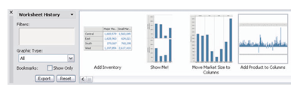
Why Study Analytic Provenance?
Reproducible Analysis:
Have a record of analysis so another person can follow what you did
Graphical Histories for Visualization: Supporting Analysis, Communication, and Evaluation. Heer et al.

Slide 8
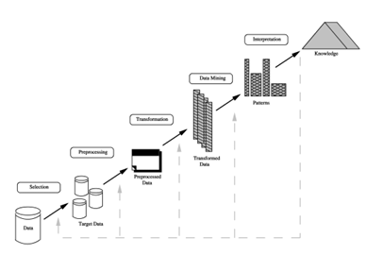
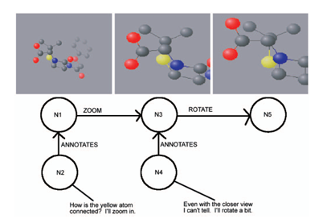
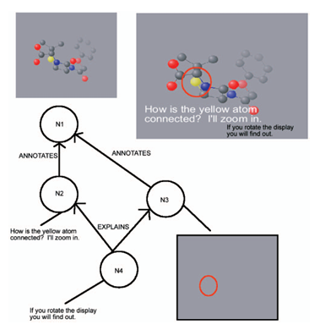
Why Study Analytic Provenance?
As a post hoc analysis:
What analysis steps are useful?
For example, in solving a difficult problem, is there a key step (or steps) that lead to success (and to failure)?
Notes:
KKDD (Knowledge Discovery in Databases)

Slide 9
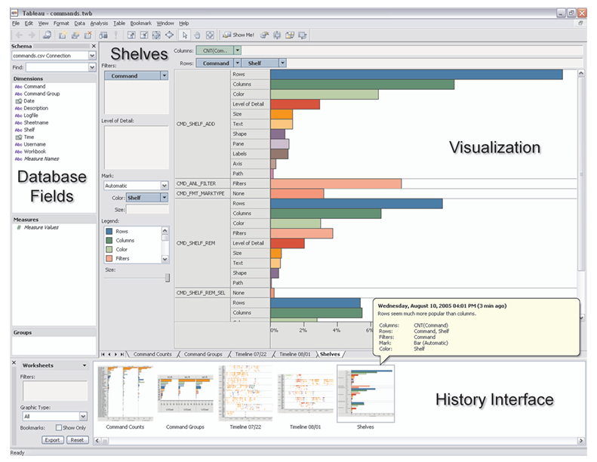
Why Study Analytic Provenance?
As a post hoc analysis:
Building a knowledge-base
If we believe that interactions encodes reasoning and analysis, can I aggregate all interactions/analyses into a knowledge-base?
Graphical Histories for Visualization: Supporting Analysis, Communication, and Evaluation. Heer et al.
Notes:
visualizing data collected from aggregated history usage logs. The panel on the left provides a list of database fields. Fields can be dragged onto visual encoding shelves in the workspace on the right to create visualizations. Multiple worksheets are supported, indicated by the named tabs underneath the visualization. The panel along the bottom shows an analysis history viewer, currently providing an overview of the current state of each worksheet. A tooltip provides details-on-demand for the selected history item.

Slide 10

Why Study Analytic Provenance?
As an ad hoc analysis (that is, in real time), determine a user’s “analytical needs”:
Analysis of search space: what data space has the user explored (and not explored)?
HindSight: Encouraging Exploration and Engagement in Data Visualization. Feng et al.

Slide 11
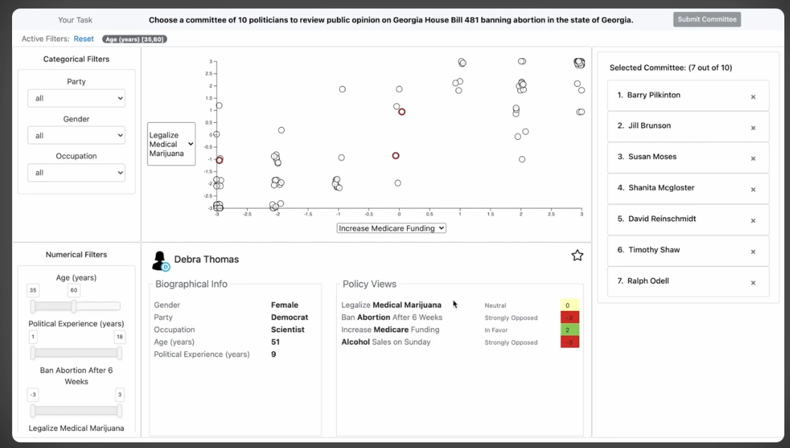
Why Study Analytic Provenance?
As an ad hoc analysis (that is, in real time), determine a user’s “analytical needs”:
Analysis of bias: is the user favoring some hypothesis and ignoring evidence?
Left, Right, and Gender: Exploring Interaction Traces to Mitigate Human Biases. Wall et al.

Slide 12
Lab
Check the course website for today’s lab

